Slide 1
The COLUMBIAN ENVELOPES
of 1893
Marvin & Judith Platt
marvinplatt@yahoo.com
The United Postal Stationery Society

Slide 2
The 1893 Columbian Envelopes
  The U.S.P.O.D. recognized the WORLD’S COLUMBIAN EXPOSITION, Chicago, Illinois, May 1 through October 30 1893 by issuing our first commemorative stamps and commemorative envelopes.
  The envelope contract awarded to the Plimpton and Morgan Envelope Company.
  A total of 107,632,218 envelopes were produced
    in four denominations and four colors: one cent blue, two cents violet, five cents brown, and ten cents slate;
    by four dies: 94, 95, 96, 97 with four die varieties: A, B, C, D; and thirty-one working dies
    eight envelope sizes: A, G, H, I, N, P, Q, R
to create 78 different envelope combinations.
Notes:
U.S.P.O.D. is US Post Office Department. PMG John Wanamaker officially authorized the production of the envelopes Order 156 Dec 5 1892

Slide 3
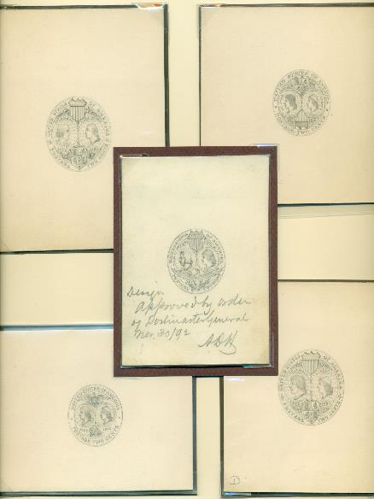
The Design
Hand drawings of essays by
Henry Michel
and of accepted design signed by Postmaster General (ADH: Hazen)
Notes:
Hand drawing of accepted design. Henry Mitchell also designed the 1876 Centennial Envelopes

Slide 4
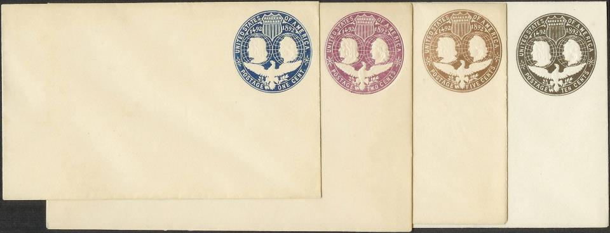




A total of 107,632,218 envelopes, U348, U349, U350, and U351, were produced by four dies: 94, 95, 96, 97; in four denominations and colors: one cent blue, two cents violet, five cents brown, and ten cents slate; …
Notes:
Note that stamp colors were similar to stamps of the same denomonation

Slide 5
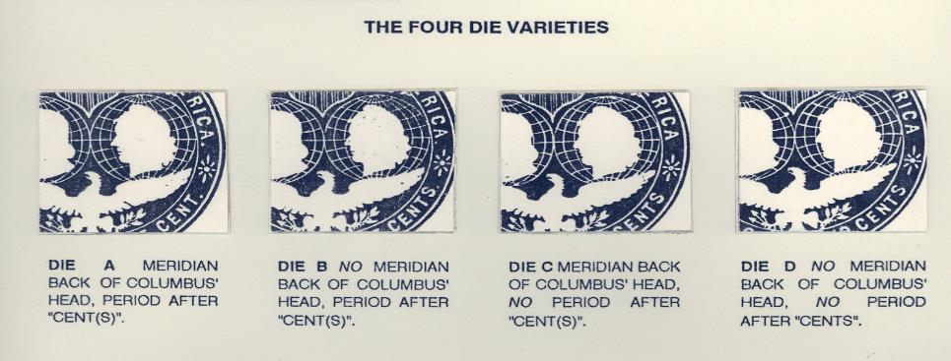
… creating four die varieties: A, B, C, D; …

Slide 6
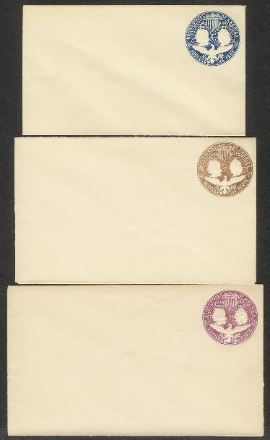
… and eight envelope sizes: A, G, H, I, N, P, Q, R …
7(A) Note & 1 cent
circular
9(P) Letter
5 cents Foreign Letter
rate for ½ oz.
11(Q) Commercial
2 cents Domestic 1 oz.
Notes:
11 sizes are shown on this slide and the following 3 slides. Note that, at this time the Post Office designated sizes by letters and name. The numbers ahead of the letters are the United Postal Stationery Society sizes for the envelope.

Slide 7
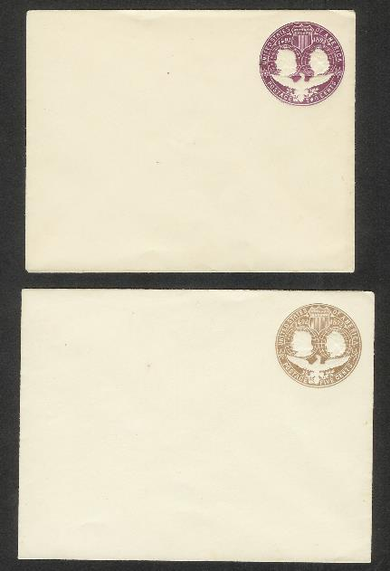
BARONIAL
16 (N) 2 cents
Domestic Rate 1 oz.
18(R) 5 cents
Foreign Letter Rate
½ oz.

Slide 8
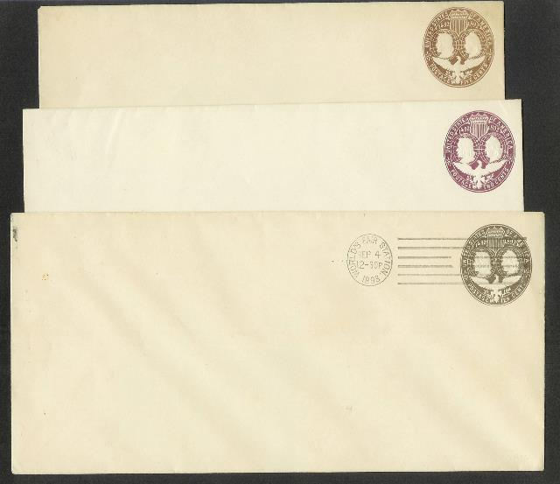
OFFICIAL
21(G)
23(H)
25(I)
10 cents paid 2 cents domestic + 8 cents Registered Letter rate

Slide 9
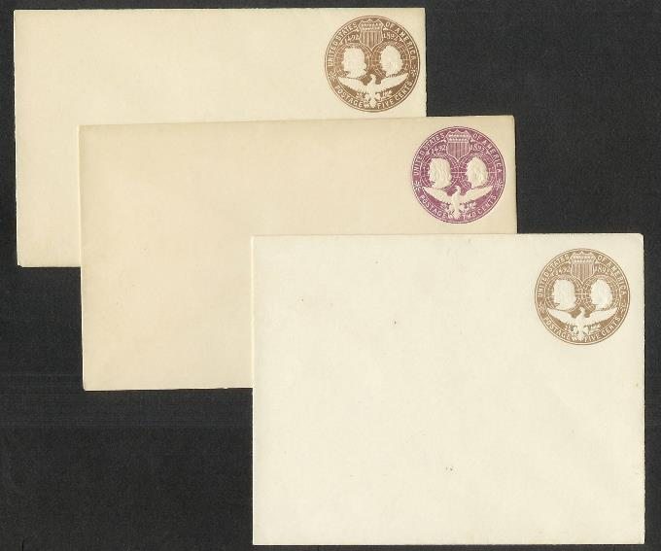
...of which P,Q, and R were new sizes to create 78 different envelope combinations.
Notes:
78 different size time denomination combinations of envelopes.
“Hartford Notes”, Mekeels Jan 12, 1893 page 23 “… Special Machinery is required for the manufacture of the new sizes and as soon as this can be completed and placed in position, which will be in a couple of weeks, the works will be able to turn out ½ to ¾ of a million Columbian envelopes in a day in addition to the number of the old style …”

Slide 10
SUMMARY OF PRODUCTION OF THE COLUMBIAN ENVELOPES
All of the envelopes were derived from the two cents master die.
Both wings of the essay were cut down.
2A1, a two cents Columbian envelope with a blunt right wing, was the first envelope produced.
Of the 107 million envelopes, 90% were two cents. There were four die varieties: A,B,C,D; twenty-two working dies and three right wing types: blunt, two feathers and one feather produced by cutting down the hub.
8% of the envelopes were of the one cent denomination. There were three die varieties: A,B,C; six working dies with three wing types: blunt, one feather and pointed.
0.7% the envelopes were of the five cents denomination. There were two die varieties: A and B and two working dies with pointed right wings.
0.2% were of the ten cents denomination. There was one die variety, C, and one working die with one feather.

Slide 11
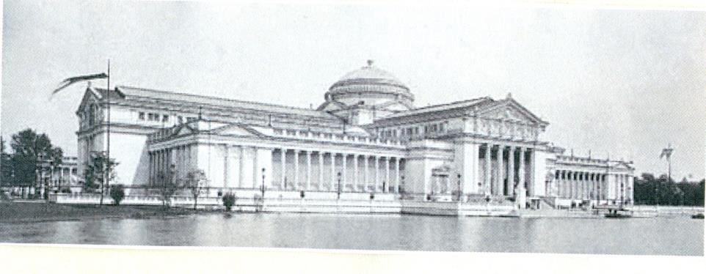
Envelope Production and EFO’s

Slide 12
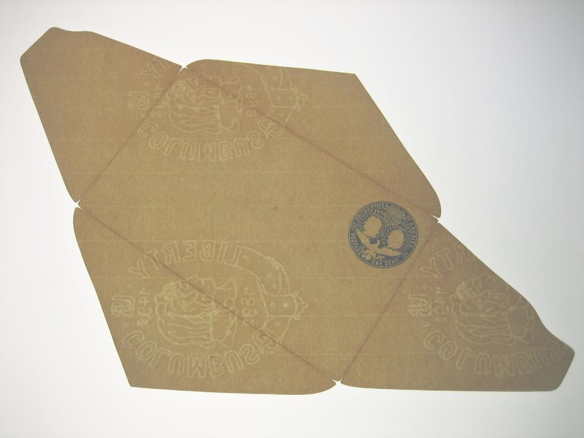
Notes:
Normal envelopes has laid lines on diagonal from lower left to upper right, occasionally lower right to upper left

Slide 13
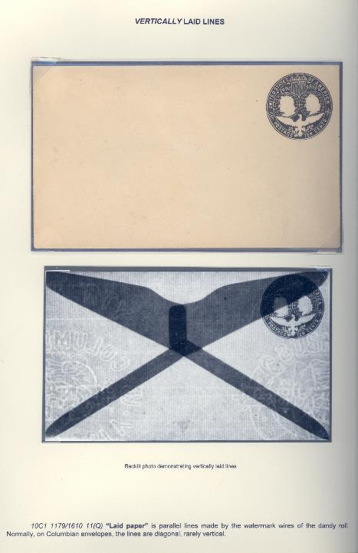

Slide 14
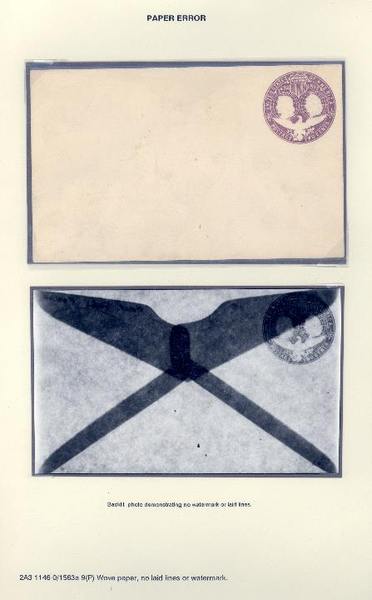

Slide 15
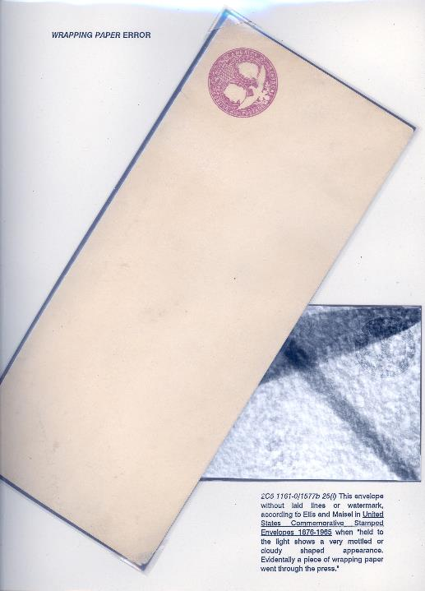

Slide 16
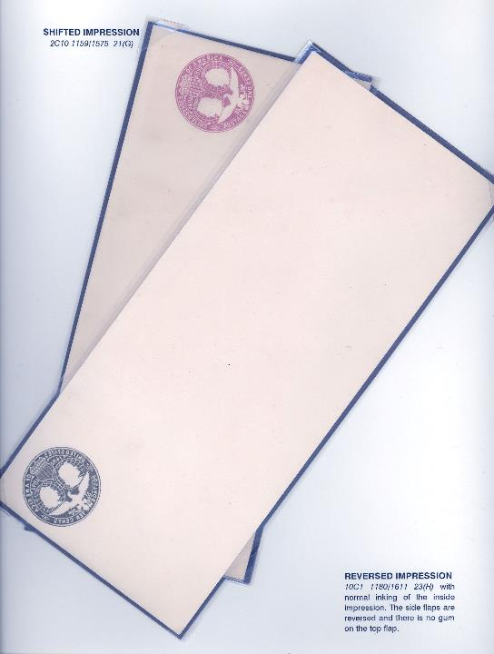

Slide 17
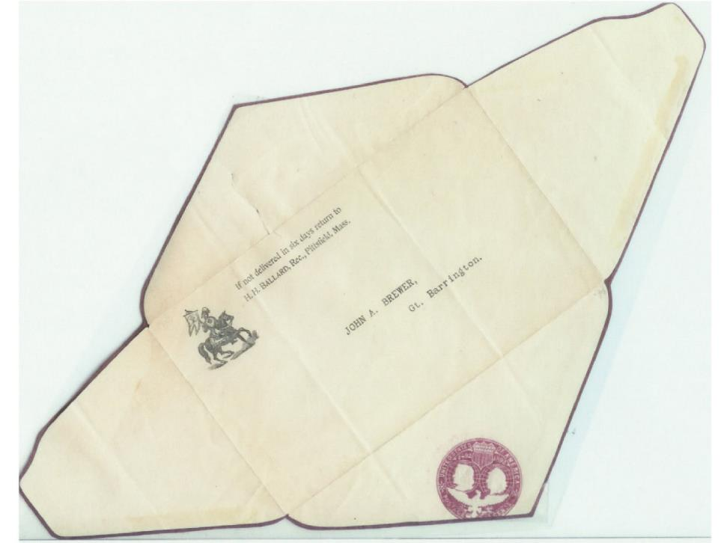
Misplaced Indicia

Slide 18
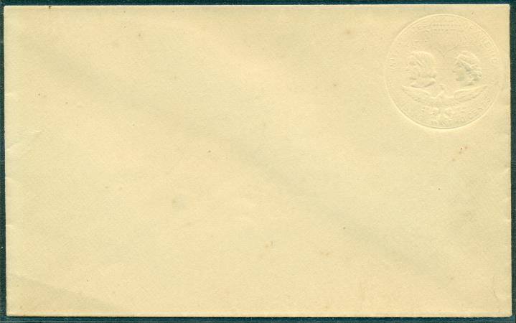
ALBINO
Notes:
Occurs when two precut envelope blanks were fed through press together; top blank received embossing and ink and bottom blank received embossing but no ink.

Slide 19
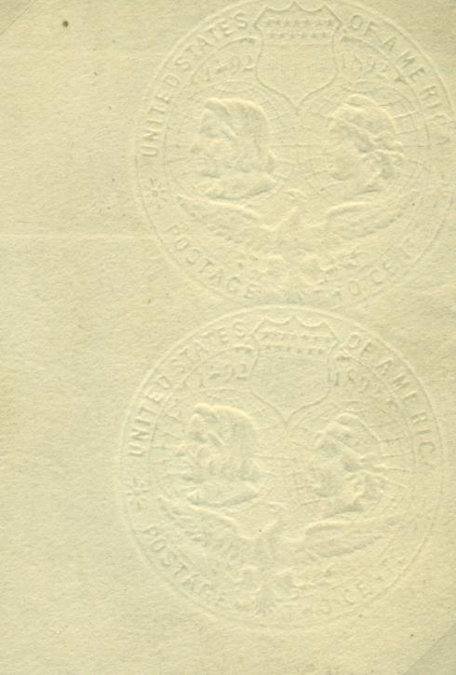
Notes:
Double impression of albino

Slide 20

… the chicken or the egg?
Notes:
Envelope embossed and printed with another sheet of paper covering part of the indicia.

Slide 21
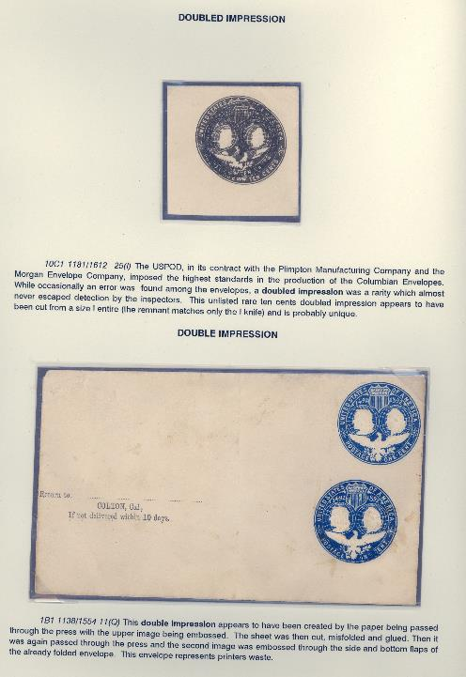

Slide 22
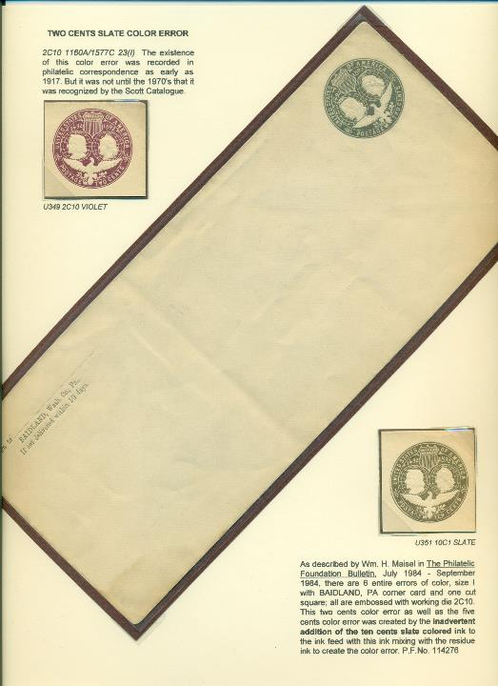

Slide 23
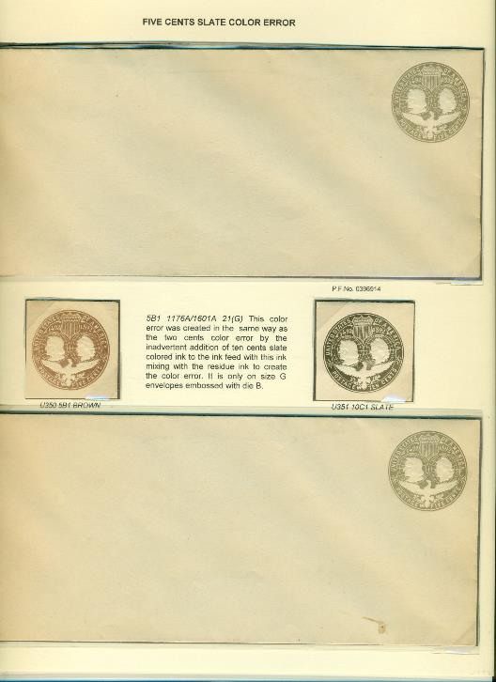

Slide 24
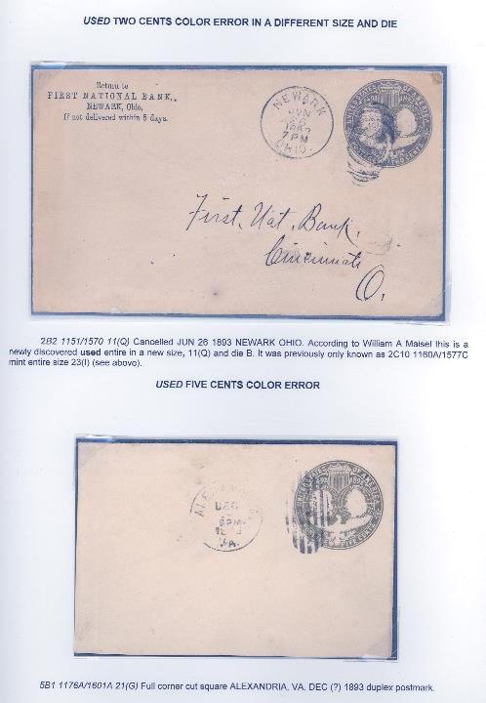

Slide 25
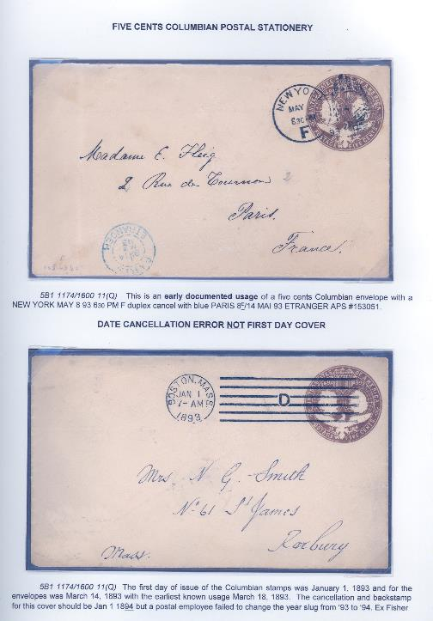

Slide 26
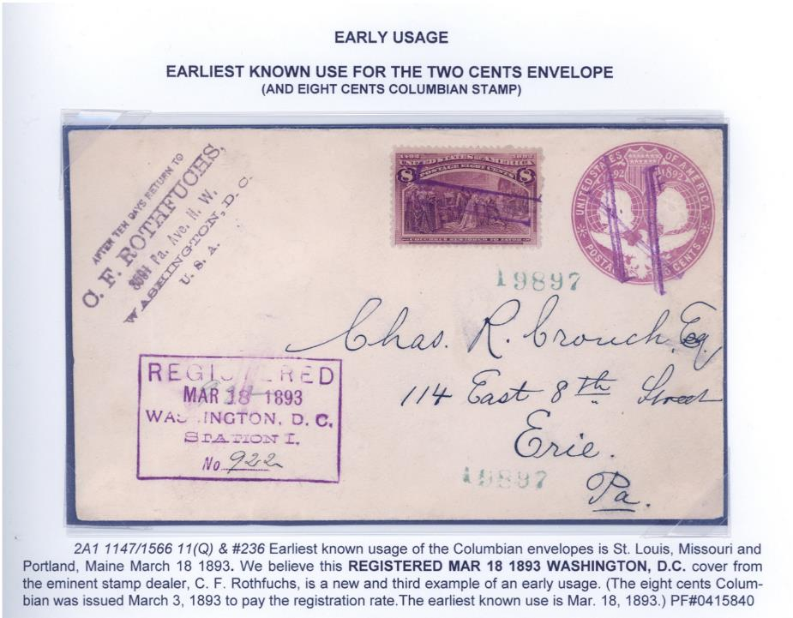
Notes:
Double human error

